Slide 1
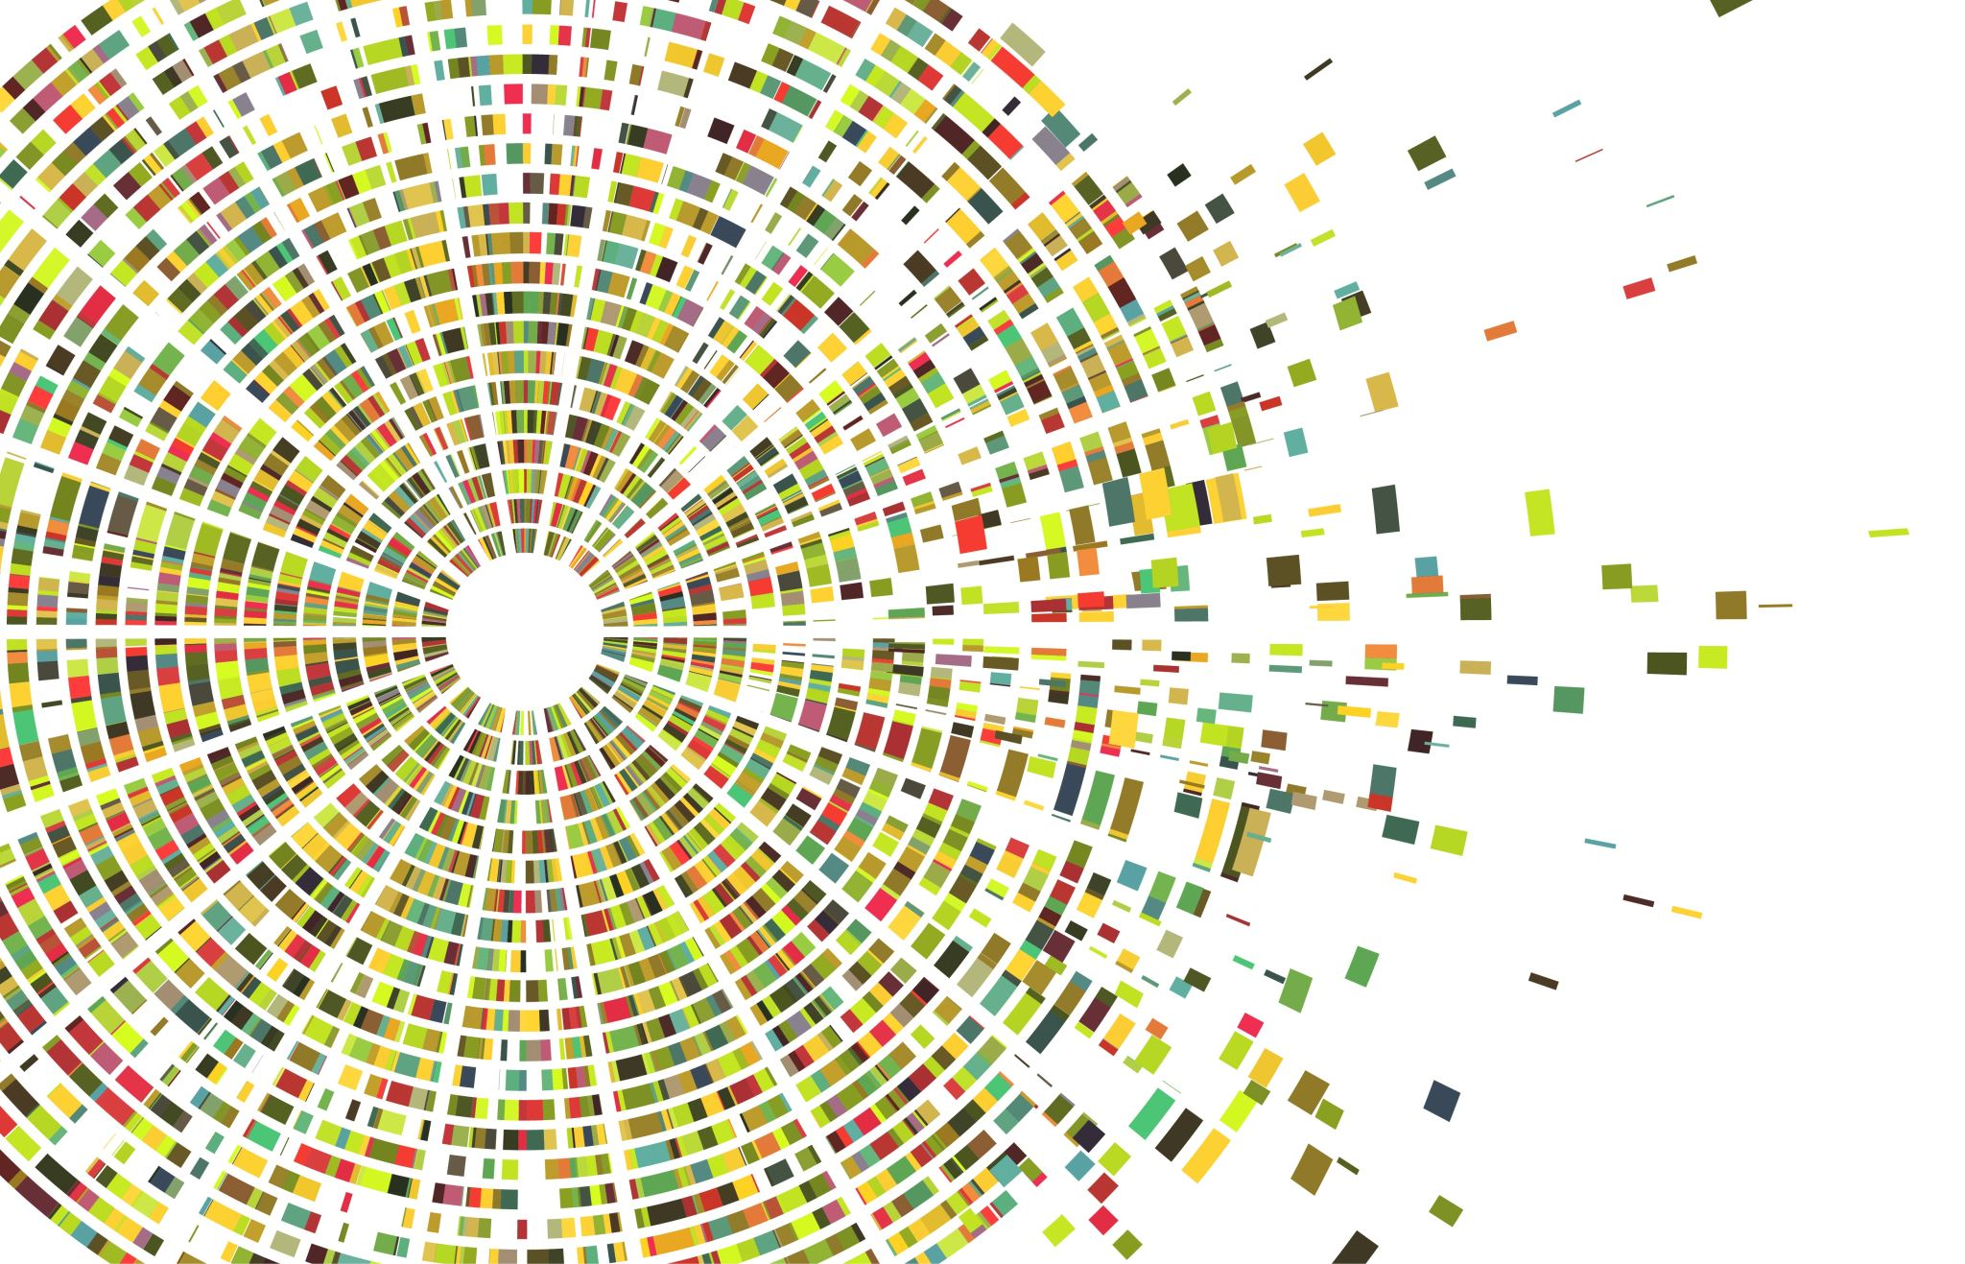

Binary Classification for Tabular Data

Slide 2
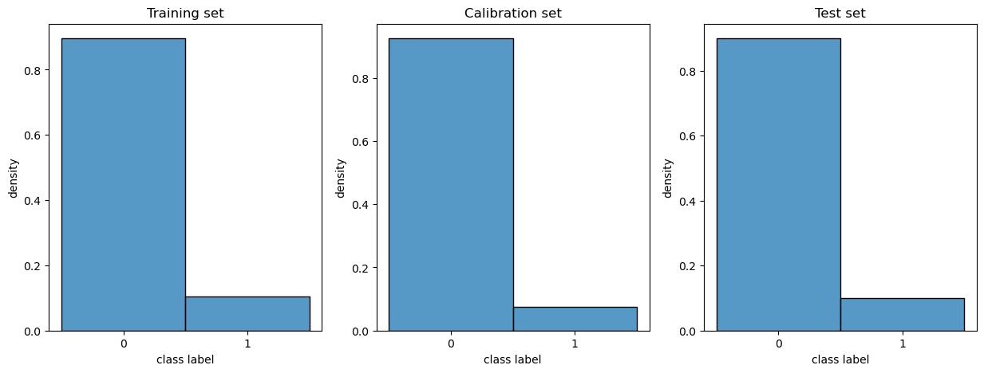
Data Preparation
Train set size: (636, 57)
Calibration set size: (160, 57)
Test set size: (199, 57)

Slide 3
Feature Selection - RFE
Selected Features: Diagnose (Numerical - Interval)
Train set size: (636, 1)
Calibration set size: (160, 1)
Test set size: (199, 1)

Slide 4
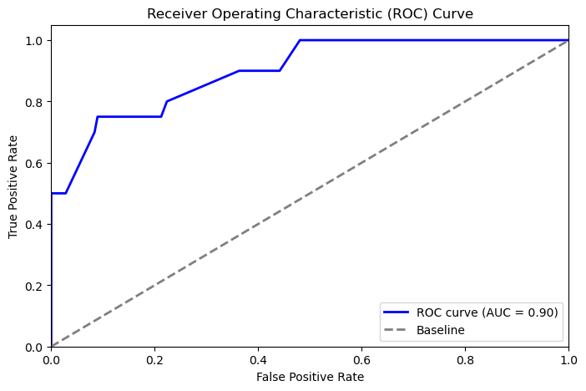
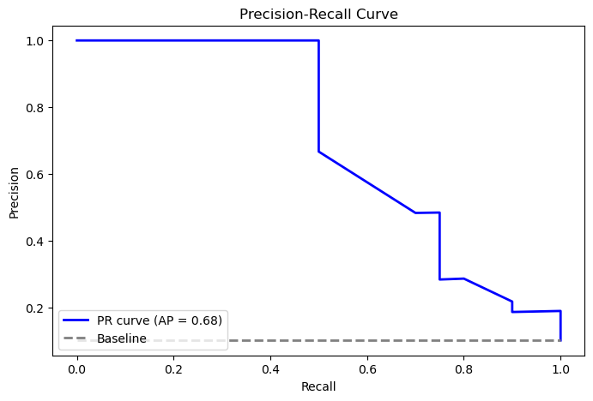
Classifier - HistGradientBoostingClassifier

Slide 5
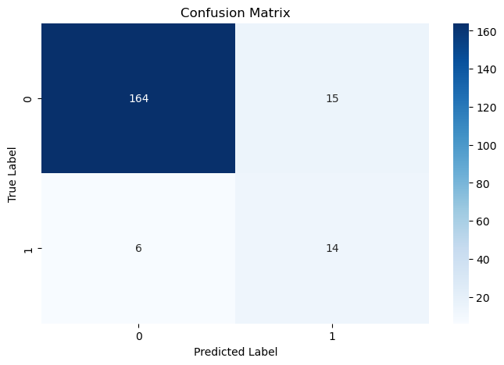
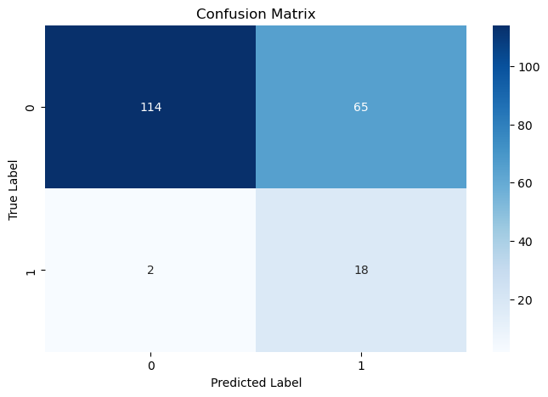
Classifier - HistGradientBoostingClassifier
Threshold = 0.5 (default)
Threshold = 0.3

Slide 6
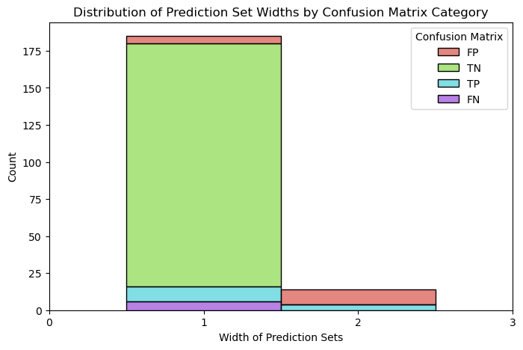
Inductive Conformal - Crepes
Significance Set (alpha) = 0.1
Results:
Coverage: 0.94
Average Set Width: 1.07

Slide 7
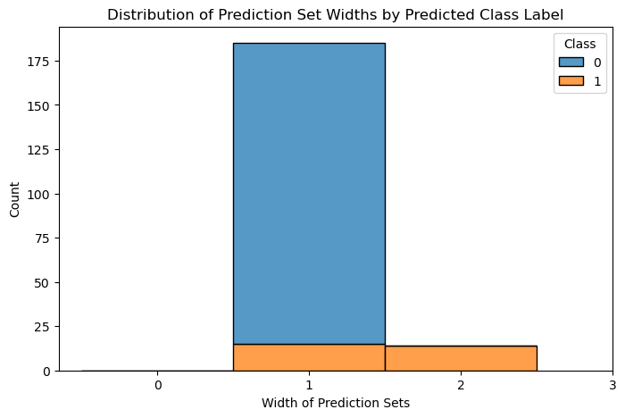
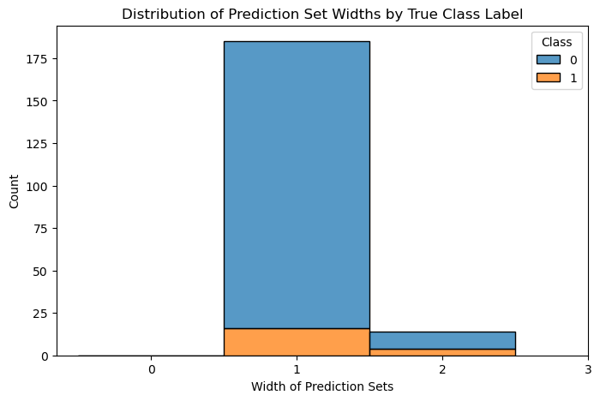
Inductive Conformal - Crepes
Significance Set (alpha) = 0.1
Results:
Coverage: 0.94
Average Set Width: 1.07

Slide 8
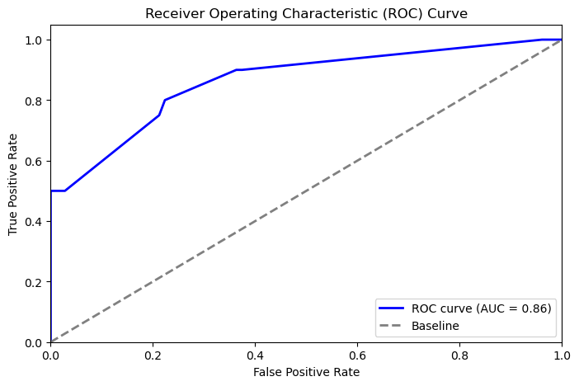
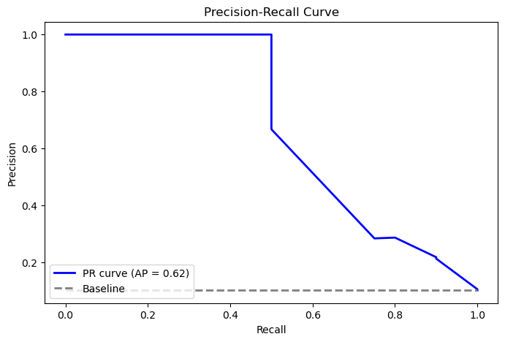
Calibration – Venn Abers

Slide 9
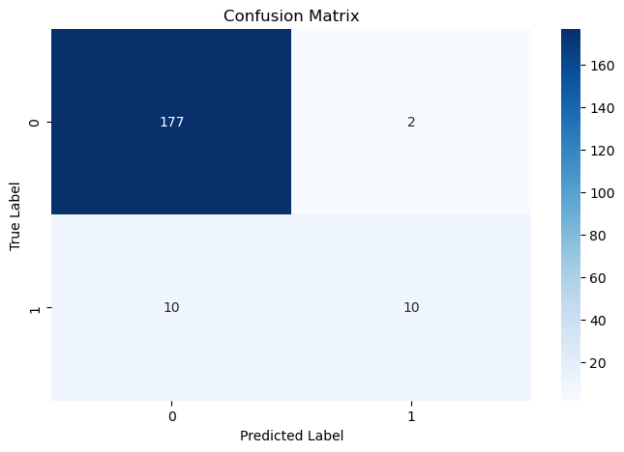
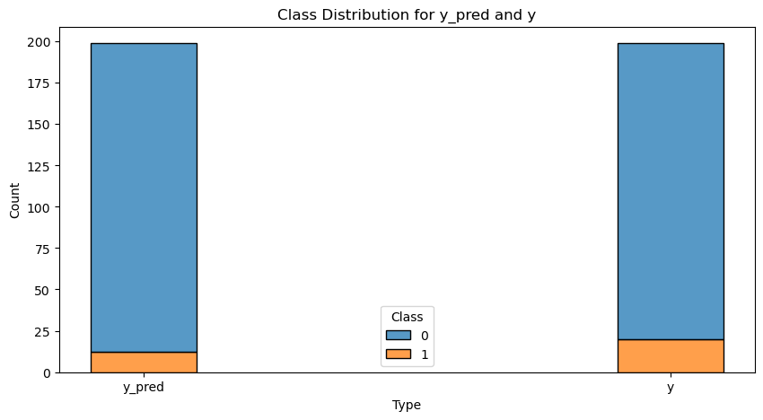
Calibration – Venn Abers

Slide 10
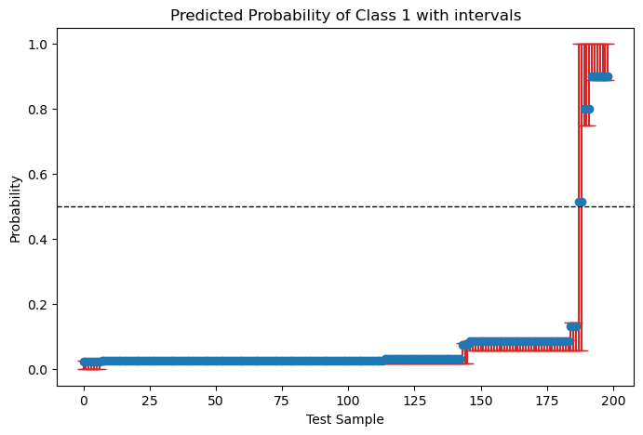
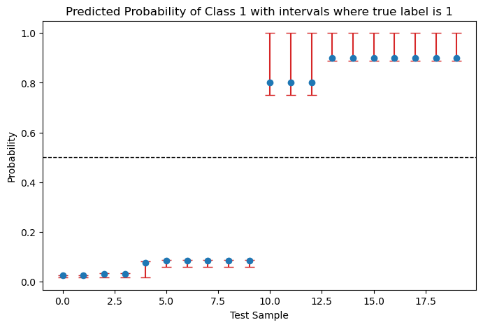
Calibration – Venn Abers

Slide 11
Inductive Conformal - Crepes
Significance Set (alpha) = 0.1
Results:
Coverage: 0.94
Average Set Width: 1.07

Slide 12
Inductive Conformal - Crepes
Significance Set (alpha) = 0.1
Results:
Coverage: 0.94
Average Set Width: 1.07

Slide 13
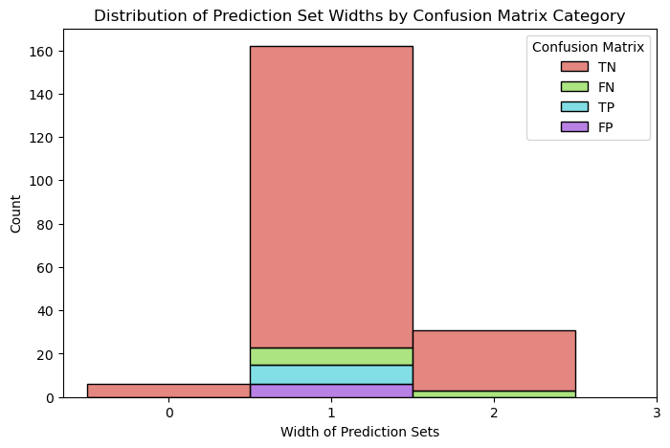
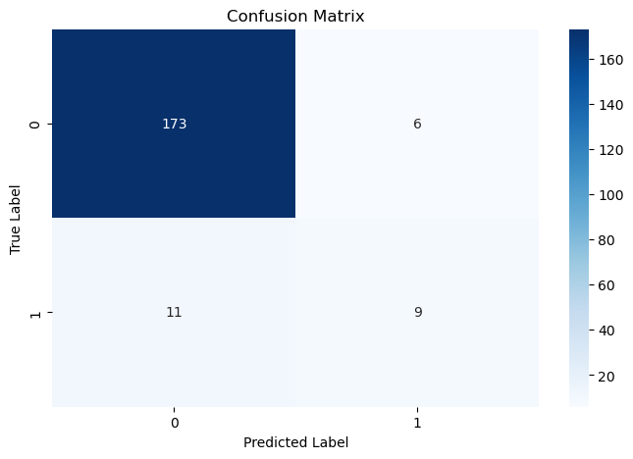
Transductive - Nonconformist
Coverage: 0.899
Average Set Width: 1.13

